Slide 1

Hierarchical
Clustering

Slide 2
Hierarchical Clustering
It is time to explore another clustering method!
Hierarchical clustering is very common in biology and lends itself nicely to visualizing clusters.
It can also help the user decide on an appropriate number of clusters.

Slide 3
Hierarchical Clustering
Section Overview:
Theory and Intuition of Hierarchical Clustering
Coding Example of Hierarchical Clustering
Note: We’ll skip an assessment for now and revisit when we discuss DBSCAN clustering for comparison.

Slide 4
Let’s get started!

Slide 5
Hierarchical
Clustering
Theory and Intuition

Slide 6
Hierarchical Clustering
Like most clustering algorithms, Hierarchical Clustering simply relies on measuring which data points are most “similar” to other data points.
“Similarity” is defined by choosing a distance metric.

Slide 7
Hierarchical Clustering
So why use Hierarchical Clustering?

Slide 8
Hierarchical Clustering
So why use Hierarchical Clustering?
Easy to understand and visualize.
Helps users decide how many clusters to choose.
Not necessary to choose cluster amount before running the algorithm.

Slide 9
Hierarchical Clustering
So why use Hierarchical Clustering?
Divides points into potential clusters:

Slide 10
Hierarchical Clustering
So why use Hierarchical Clustering?
Divides points into potential clusters:
Agglomerative Approach:
Each point begins as its own cluster, then clusters are joined.
Divisive Approach:
All points begin in the same cluster, then clusters are split.

Slide 11
Hierarchical Clustering
Hierarchical Clustering
Divides points into potential clusters:
N1
N2
N3
N4
N5
N6

Slide 12
Hierarchical Clustering
Hierarchical Clustering
Agglomerative:
N1
N2
N3
N4
N5
N6

Slide 13
Hierarchical Clustering
Hierarchical Clustering
Agglomerative:
N1
N2
N3
N4
N5
N6

Slide 14
Hierarchical Clustering
Hierarchical Clustering
Agglomerative:
N1
N2
N3
N4
N5
N6

Slide 15
Hierarchical Clustering
Hierarchical Clustering
Agglomerative:
N1
N2
N3
N4
N5
N6

Slide 16
Hierarchical Clustering
Opposite of the Agglomerative approach is a Divisive approach, which starts with all points belonging to the same cluster, and the begins divisions to separate out clusters.

Slide 17
Hierarchical Clustering
Hierarchical Clustering Process
Compare data points to find most similar data points to each other.
Merge these to create a cluster.
Compare clusters to find most similar clusters and merge again.
Repeat until all points in a single cluster.

Slide 18
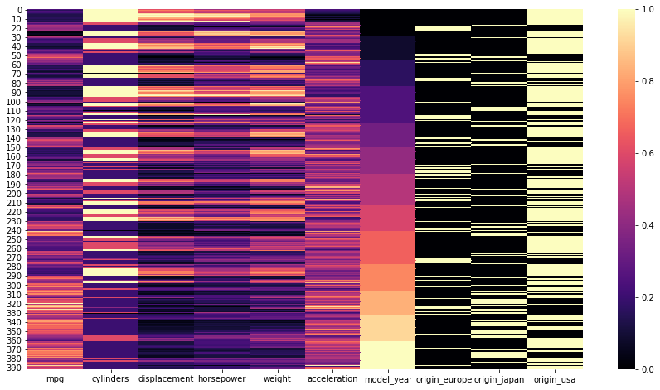
Hierarchical Clustering
Hierarchical Clustering Process

Slide 19
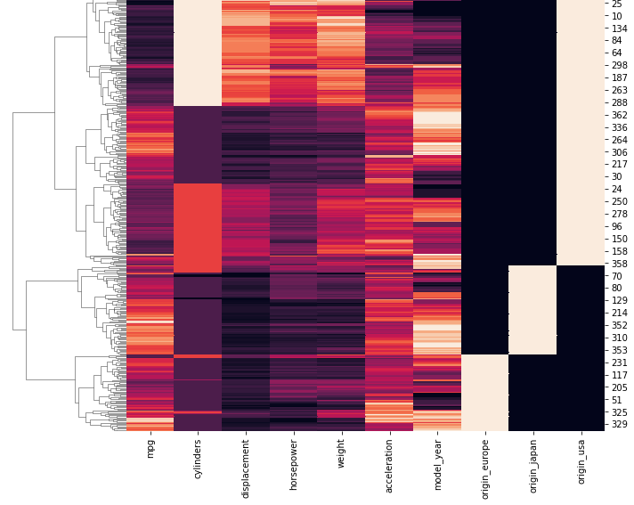
Hierarchical Clustering
Hierarchical Clustering Process

Slide 20
Hierarchical Clustering
There are a few key topics we still need to understand for Hierarchical Clustering:
Similarity Metric
Dendrogram
Linkage Matrix

Slide 21
Hierarchical Clustering
Similarity Metric
Measures distance between two points.
Many options:
Euclidean Distance
Manhattan
Cosine
and many more...

Slide 22
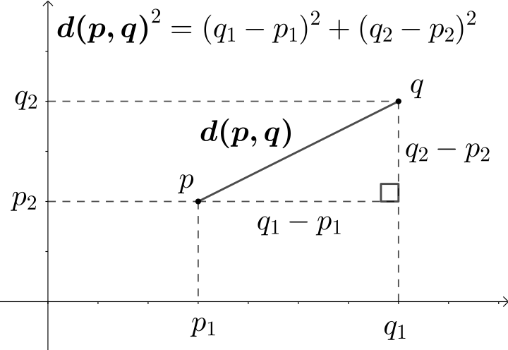
Hierarchical Clustering
Similarity Metric
Default choice is Euclidean

Slide 23
Hierarchical Clustering
Similarity Metric
Default choice is Euclidean

Slide 24
Hierarchical Clustering
Similarity Metric
Each dimension would be a feature
For n data points and p features:
D² = (x₁₁ - x₁₂)² + … + (x_{n-1p-1} - x_{np})²

Slide 25
Hierarchical Clustering
Similarity Metric
Each dimension would be a feature
For n data points and p features:
D² = (x₁₁ - x₁₂)² + … + (x_{n-1p-1} - x_{np})²
Using MinMaxScaler we can scale all features to be between 0 and 1.
This allows for maximum distance between a feature to be 1.

Slide 26
Hierarchical Clustering
Dendrogram:
Plot displaying all potential clusters.
Very computationally expensive to compute and display for larger data sets.
Very useful for deciding on number of clusters.

Slide 27
Hierarchical Clustering
Dendrogram:
N1
N2
N3
N4
N5
N6

Slide 28
Hierarchical Clustering
Dendrogram:
Distance
N1
N2
N3
N4
N5
N6

Slide 29
Hierarchical Clustering
Dendrogram:
Distance
N1
N2
N3
N4
N5
N6

Slide 30
Hierarchical Clustering
Dendrogram:
Distance
N1
N2
N3
N4
N5
N6

Slide 31
Hierarchical Clustering
Dendrogram:
“Slice” to decide cluster count
N1
N2
N3
N4
N5
N6

Slide 32
Hierarchical Clustering
Dendrogram:
“Slice” to decide cluster count
N1
N2
N3
N4
N5
N6

Slide 33
Hierarchical Clustering
Dendrogram:
“Slice” to decide cluster count
N1
N2
N3
N4
N5
N6

Slide 34
Hierarchical Clustering
Dendrogram:
“Slice” to decide cluster count
N1
N2
N3
N4
N5
N6

Slide 35
Hierarchical Clustering
Linkage
How do we measure distance from a point to an entire cluster?
How do we measure distance from a cluster to another cluster?

Slide 36
Hierarchical Clustering
Linkage
Once two or more points are together and we want to continue agglomerative clustering to join clusters, we need to decide on a linkage parameter.

Slide 37
Hierarchical Clustering
Linkage
X2
X1

Slide 38
Hierarchical Clustering
Linkage
X2
X1

Slide 39
Hierarchical Clustering
Linkage
X2
X1

Slide 40
Hierarchical Clustering
Linkage
X2
X1

Slide 41
Hierarchical Clustering
Linkage
X2
X1

Slide 42
Hierarchical Clustering
Linkage
Criterion determining which distance to use between sets of observation.
Algorithm will merge pairs of clusters that minimizes the criterion.

Slide 43
Hierarchical Clustering
Linkage:
Ward: minimizes variance of clusters being merged.
Average: uses average distances between two sets.
Minimum or Maximum distances between all observations of the two sets.

Slide 44
Hierarchical Clustering
Let’s move on to exploring these concepts through code!

Slide 45
Hierarchical
Clustering
Theory and Intuition Part Two: Linkages

Slide 46
Hierarchical
Clustering
Theory and Intuition Part One: Basics

Slide 47
Hierarchical
Clustering
Coding Part One: Data and Visualization

Slide 48
Hierarchical
Clustering
Coding Part Two: Clusters and Dendrograms

